Slide 1

Final Project II

Slide 2
Currently
What You Should Have?
A Data Set
Exploration on Multiple Angles
Preliminary Visuals or Tables
Detailed Follow-Up Questions
Investigation on Questions
Final Steps
Narrow Down All Work to Two Questions of Interest
Practice Predictive Modeling
Use Multiple
Evaluate and Compare Models on Predictive Accuracy

Slide 3
Currently
Presentation and Paper
Highly Related
All Group Members Should Be Involved in Both Parts
Advice: Paper Presentation
Feel Free to Notify Me if…
A Member has Dropped
A Member has Avoided Work
A Member has Been Utterly Useless
A Member is Outstanding
Full Privacy in Email

Slide 4
Part 3 Final Paper
RMarkdown Template Included
Sections of Paper
Introduction
Data
Results
Conclusion
Read Description and Look at Template Provided Online
Detailed Rubric Combines Objectivity and Subjectivity

Slide 5
Part 4 Final Paper
Introduction
States Two Questions
Explains Why They Are Interesting or Important
Should Excite the Reader
Grading
2 Clearly Defined Questions
Am I Interested?
Free of Errors

Slide 6
Part 4 Final Paper
Data
Describes
Source of Data
Variables of Interest
Observations
Descriptive Figures and Stats
1 Table Printed Nicely
1 Figure Printed Nicely
Grading
Data Adequately Described
Table (2 Points)
Figure (2 Points)
Free of Errors

Slide 7
Part 4 Final Paper
Results
Use Predictive Modeling Techniques for Questions
Clearly Explain the Methods and Models Considered
Multiple Models For Each Question
Clearly Explain the Results and How They Answer Your Question

Slide 8
Part 4 Final Paper
Results
The Longest Part of the Paper
Advice: Organize Into Subsections
Grading
Appropriate Methods with Multiple Models
Adequate Explanation of Results
4 Figures and/or Tables (2 Points Each)
Free of Errors

Slide 9
Part 4 Final Paper
Conclusion
Restate Questions Along with Summarized Results
Why are These Results Interesting to Those Who May Care about the Data?
Where Do We Go from Here?
Grading
Summarize Questions and Results
Do I Want to Learn More?
Free of Errors

Slide 10
Part 3 Final Paper
Final HTML (D)
Submit on Sakai
No R Code
Figures Should Be Labeled, Colored, and Appropriate
Tables Should Be in HTML
xtable Package
kable Package
Completely Free of Grammatical/ Spelling Error
echo=FALSE

Slide 11
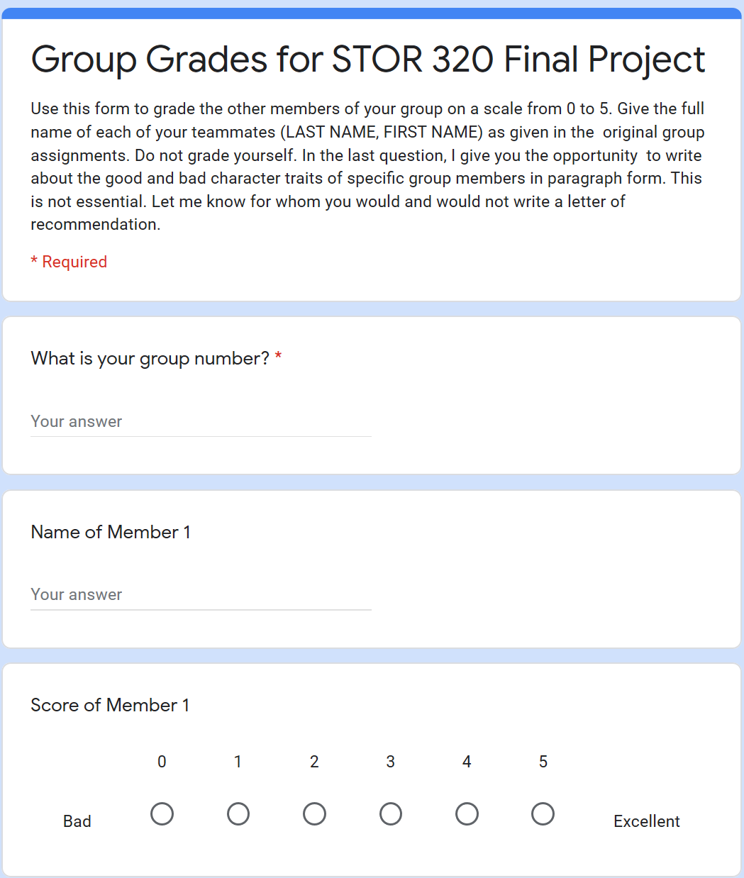
Part 3 Final Paper
Group Scoring (CIOD)
See Google Form Link
Score Members from 0 to 5
Don’t Score Yourself
Don’t Fill Out Form if Giving Each Group Member a 5

Slide 12
Part 4 Final Presentation
Select 1 of 2 Questions (CIOD)
Presentation Details (O)
4-7 Minutes
Slideshow Presentation
At Least 4 Visuals (Graphics or Tables)
Ordered by Group Number
Subjective Grading (O)
Explanation of Question
Explanation of Methods
Organization of Content
Eye Contact/Body Language
Slide Quality

Slide 13
Part 4 Final Presentation
All Members Involved (CIOD)
Creation of Slides
Organization of Content
Practice Presentation
Proofreading of Slides
Attendance (5 Points)
Submit Slides on Sakai (D)
Read Description on Course Website

Slide 14
Closing
Disperse and Make Reasonable Decisions

